Slide 1
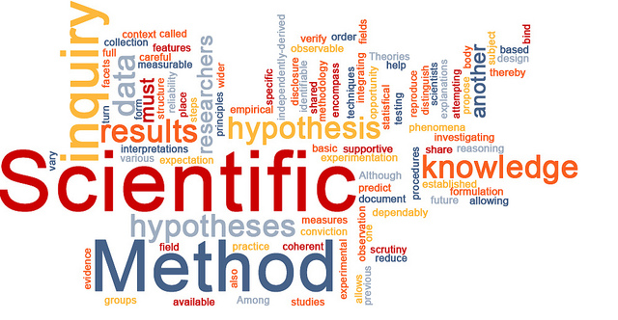

Thinking like a Psychological Scientist
[Professor Name]
[Class Section Number]
Notes:
Classroom Recommendations: This PowerPoint is designed to present this information over the course of one (75-minute) class. This information could be expanded to cover two days, if you add some activities from the Noba Instructor Manual or if you extend the amount of time in the current activities.
Overview: This module provides an introduction to the foundations of scientific thinking, theory, and research. The goal of the content of this module and these slides is to help our students think about knowledge and belief with more nuance (e.g., scientific theories cannot be simply discarded as “just a theory” because science is trustworthy, but not all scientific claims have equal merit).
The content of this module overlaps with material introducing what science is, research methods, and statistical reasoning, though it is differentiated from this material in its more conceptual tone and perspective. Although this material is fundamental to psychology, many students may find it difficult to think about the trustworthiness and evaluation of knowledge from a conceptual perspective. To help students, we have attempted to provide concrete examples of abstract concepts throughout. Although this lecture is prepared with a single 60-minute class session in mind, instructors who would like to spend more time on this content can use some of the further discussion/activity prompts throughout these slides to do so.
Technical Note: These slides may contain simple click animation so that you can focus students’ attention on a particular question, a selection of text, or an image and not have them be distracted by reading ahead. You can either preview the sequence of animation by going through the slides in slideshow view, visiting the animations tab, or reviewing the slide notes. In the notes you will see a cue - (Click) – that corresponds to each animation.
Optional Activity: At the start of class, have students discuss what images come to mind when they hear the word “scientist.” Here are some questions that may be useful in the discussion:
What does it mean to “think like a psychological scientist”?
What kinds of work do scientists and psychologists do?
Is there value in scientific research (any why do you think that)?
Is scientific research trustworthy (and why do you think that)?
Do you think our society values scientific research and respects the scientists who produce it? Why/why not?
Alternatively: You can use clickers/a polling software to gather adjectives from students to the question, “What words come to mind when you hear “thinking like a psychological scientist”?
Perspectives from these discussions can be used to compare/contrast with material throughout the lecture. (Ex. “Skeptical” was a word that came up at the beginning of this lecture. NHST has the default stance of skepticism—that there is no relationship between variables—built in!”)

Slide 2
Overview
Introduction
Scientific Reasoning and Theories
Interpreting Research (Correctly)
Trusting Science without Proof
Objectivity in Science
Conclusion
Notes:
The purpose of this slide is to provide students with an overview of the material that will be covered during the lecture.
Technical Note: These slides may contain simple click animation so that you can focus students’ attention on a particular question, a selection of text, or an image and not have them be distracted by reading ahead. You can either preview the sequence of animation by going through the slides in slideshow view, visiting the animations tab, or reviewing the slide notes. In the notes you will see a cue - (Click) – that corresponds to each animation.
You will also find hyperlinks to outside videos at various places in the slides. These hyperlinks are embedded in text and indicated by color and in the notes section.

Slide 3

What does it mean to “be healthy?”
Notes:
This slide introduces students to the topic of scientific thinking by encouraging them to think about how they know what they do, and why they should trust their beliefs. The example given is one that should be relevant to students: how do they know that they way that they study for classes is effective?
Other possible points of discussion could be drawn from psychological research, as well (e.g., what makes people happy: money versus relationships; what is the best way to take notes: on a computer or by hand).
Discussion Question: Ask students to reflect on what “being healthy” means to them.
Discussion Activity: Break students into small groups to develop a definition/description of what it means to be healthy. Ask them to be specific (e.g., “What kinds of things do healthy people eat? Do? Think? Feel?). Invite them to supplement their responses with internet searches. Ask students to share their definitions and make a list of the various features of health. Note when the same features appear on multiple lists.
Now ask: How can we know which of these, especially when there are conflicts, are part of good health? (i.e., Should I adopt a vegetarian diet or eat mostly meat with some berries?)
Explanation: One way of answering this second question, which concerns the evaluation of information, is by saying that “everyone can believe and do what they want” which (although true) has consequences. Believing that smoking won’t give you cancer isn’t sufficient to actually stop the development of cancer. Another option is by appealing to the masses; things that tend to pop up more frequently must be healthy. Right? But how do we know that is true? And it’s this same “conventional wisdom” that led to blood letting, lobotomies, and cocaine to treat tooth pain. This suggests that there needs to be something more than “a lot of people agree”.
The goal of this module is to explain how science contributes to our correct understanding about the world. The module (and these slides) will cover features of scientific reasoning and theories, interpreting scientific research, and the trustworthiness and limits of science.

Slide 4
Overview
Introduction
Scientific Reasoning and Theories
Interpreting Research (Correctly)
Trusting Science without Proof
Objectivity in Science
Conclusion
Notes:
The purpose of this slide is to provide an overview of the material that will be covered in the lecture. This section discusses the “Scientific Versus Everyday Reasoning” section of the module.
Technical Note: These slides may contain simple click animation so that you can focus students’ attention on a particular question, a selection of text, or an image and not have them be distracted by reading ahead. You can either preview the sequence of animation by going through the slides in slideshow view, visiting the animations tab, or reviewing the slide notes. In the notes you will see a cue - (Click) – that corresponds to each animation.
You will also find hyperlinks to outside videos at various places in the slides. These hyperlinks are embedded in text and indicated by color and in the notes section.
Explanation: We will start with features of scientific reasoning and theories.

Slide 5
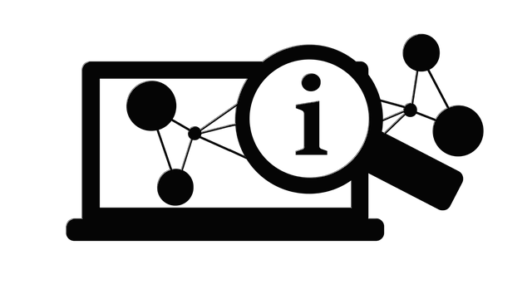
Scientific Reasoning & Theories
Testing hypotheses based on samples using inductive reasoning
Notes:
This slide begins the discussion on Scientific Reasoning and Theories.
Discussion Topic: With the list of qualities of “health”, choose one or two to illustrate these ideas. For example, if students suggest that “being healthy” involves cardio exercise multiple times a week, follow this example through to illustrate these key terms.
Explanation: We often read (and offer) statements about the way the world works as if they were facts. (“If you want to be healthy, you need to exercise 3x/week for at least 30 minutes.”) But what is the basis for these facts? Sometimes it’s personal experience, anecdote, or collective wisdom (as the introduction exercise illustrated). This is where scientific approaches offer a unique-and important-way to distinguish claims that are true from claims that may sound plausible and may even be consistent with our personal experience, but are not accurate about the world more generally.
The core of the scientific enterprise is testing hypotheses. Hypotheses are predictions about the way the world works that are testable (“empirical statements”). In order to test these hypotheses, scientists recruit a sample, a subset of the population we are interested in. For example, if we are interested in testing the hypothesis that healthy people exercise 3x/week, we can’t test every single person; rather, we find a smaller sample of people to test. Then, using inductive reasoning, we make generalizations about the larger population that we couldn’t test based on the smaller sample. This process of making general conclusions based on a limited number of samples is called inductive reasoning.

Slide 6
Inductive Reasoning
What comes next?
But what if you knew this?
Notes:
This slide discusses inductive reasoning.
Discussion Topic: Based on the information here, what would you believe about what comes next? What is your hypothesis? (A rectangle.)
(Click.) But what if you had this information available to you; a larger sample of “data”? Based on this new information, you have a different prediction about the pattern.
Explanation: This demonstrates that the more information you have (e.g., larger sample), the better your inferences, your conclusions based on the inductive reasoning process, are going to be. So consider now what this means for assessing conclusions based on inductive reasoning. A few key principles emerge:
The quantity of the data matter; personal anecdote is inherently limited.
Measurement of a sample cannot prove a conclusion; there is always probability involved. More on this in a few slides.
Further Explanation: Inductive reasoning is not unique to science; most of the reasoning we do is inductive. When we meet someone for the first time and conclude “this is a nice person” we are drawing a general conclusion on a limited sample of data. If this is the case, than why should we trust scientific conclusions more than conclusions we reach based on personal experience if they both use this inductive process? What distinguishes scientific induction is the control over, quality and quantity of the observations.
Further Discussion Topic: Why would control over, quality and quantity of the observations influence the trustworthiness of the conclusion that is based on those observations?
If Consumer Reports, an independent research group who assesses the quality of various consumer items, suggests that the most reliable vehicle available is a Toyota, but your friend just purchased that car and has had nothing but trouble with it (e.g., it’s needed a lot of repairs), what information should be most meaningful to you and why? Should you buy or avoid that Toyota?

Slide 7
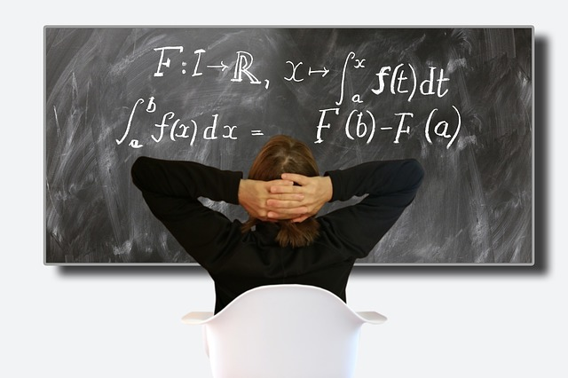

Features of Good Scientific Theories
Accuracy
Notes:
This slide discusses accuracy a feature of a good scientific theory according to Thomas Kuhn, historian and philosopher of science. For instructors with limited time, it is suggested to focus the discussion on falsifiability.
Explanation: Accuracy refers to a match between our scientific theories and empirical observations and what we actually see in the real world.
Further Explanation: Although the geocentric model of the universe is inaccurate, part of why it wasn’t immediately abandoned with Copernicus’ (1543) publication proposing a heliocentric model was because the geocentric model still accounted for the observations and data available decently well (at least not worse than the heliocentric model). It wasn’t until additional measurements were collected and more refined measurement tools developed that it because clear that the heliocentric model was superior to the geocentric model. These data and measurement tools brought the accuracy of the geocentric model into question.
Another example is the theory of the “refrigerator mother” as a cause of autism/schizophrenia. Despite the apparent initial consistency, additional observations made these theories untenable because they were not consistent with observations in the real world.
Optional Activity: For Kuhn’s 5 features, an optional activity could include breaking students into groups to develop/search for specific examples of these features (historically or in recent research debates). Individual groups could each be given a different feature and asked to report back to the class with their examples. Examples could be used/elaborated/critiqued to illustrate these concepts.
Here are Kuhn’s 5 features:
Accuracy
Explanations and theories match real-world observations
E.g. Although people say, “opposites attract,” theories that focus on the role of partner similarity do a better job of explaining the observed data
Consistency
A theory has few exceptions and shows agreement with other theories within and across disciplines.
E.g. The theory of evolution explains many findings across biology and psychology predicting, for example, that humans are better able to solve problems presented in concrete rather than abstract terms
Scope
Extent to which a theory extends beyond currently available data, explaining a wide array of phenomena.
E.g. There is a theory that people use mental “short cuts” when making decision rather than weighing every single piece of evidence. This can be seen in consumer purchasing behavior, in romantic relationships, in charitable donations, and in health choices.
Simplicity
When multiple explanations are equally good at explaining the data, the simplest should be selected.
E.g. The simplest explanation for why “good” people sometimes do “bad” things is because they succumb to some outside influence
Fruitfulness
The usefulness of the theory in guiding new research by predicting new, testable relationships.
E.g. The explanation that competition leads to improved performance can be tested by researching different types of competition

Slide 8
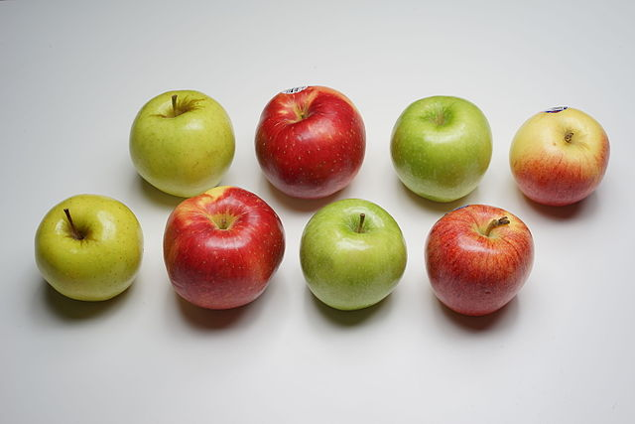
Features of Good Scientific Theories
Consistency
Notes:
This slide discusses consistency as a feature of a good scientific theory according to Thomas Kuhn, historian and philosopher of science. For instructors with limited time, it is suggested to focus the discussion on falsifiability.
Explanation: Consistency in scientific theories refers to two related ideas: consistency within the theory itself and consistency with other theories, including theories in other disciplines.
Further Explanation: For example, there is a lot of evidence suggesting that advertising has different effects based on whether the individual processes the information deeply (explicit/ analytic, “system 2” reasoning) or superficially (implicit/gist, “system 1” reasoning). A theory of consumer behavior needs to account for this; failure to do so would be inconsistent with the dual process theory of human cognition.
Another example of consistency concerns the exception. A theory that applies to some people in some circumstances on every third Thursday is more difficult to support than one with fewer exceptions. (However, with sufficient data and documentation of these exceptions, a new theory could be developed to explain the exceptions.)
Optional Activity: For Kuhn’s 5 features, an optional activity could include breaking students into groups to develop/search for specific examples of these features (historically or in recent research debates). Individual groups could each be given a different feature and asked to report back to the class with their examples. Examples could be used/elaborated/critiqued to illustrate these concepts.

Slide 9
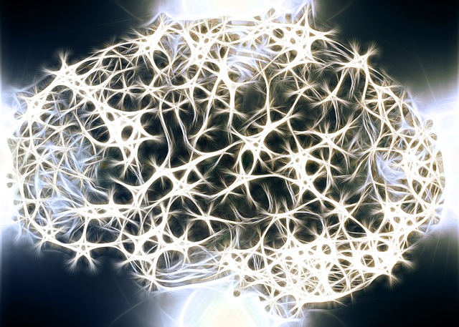
Features of Good Scientific Theories
Scope
Notes:
This slide discusses scope as a feature of a good scientific theory according to Thomas Kuhn, historian and philosopher of science. For instructors with limited time, it is suggested to focus the discussion on falsifiability.
Explanation: Theories explain a wide scope of otherwise potentially isolated research findings. In addition to explaining empirical data currently available, good scientific theories reach beyond what there is evidence for to posit potential explanations for currently untested (but likely) hypotheses. This is what we mean by scope. A theoretical explanation that moves beyond data to explain phenomena in a variety of domains is more powerful than one that does not.
Scope is similar to fruitfulness in that it moves beyond currently available data; scope, however, it is primarily concerned with explaining a wide number of observations/phenomena.
Further Discussion Topic: Consider the neuroplasticity, the idea that your brain can change and reorganize as a function of experience. There is considerable research currently dedicated to unpacking when and how neuroplasticity occurs (this research is testing the scope of the statements about neuroplasticity), but the concept itself reaches well beyond “brain function.” (Note that the movement toward the acceptance of neuroplasticity, relative to the idea that the brain is formed and relatively stagnant after a developmental “critical period,” could also be used to describe accuracy: a match between observations and theory.)
Note: The image here is meant to demonstrate that the theory of neuroplasticity has implications not just for understanding the human brain/biology, but also multiple domains of human behavior/social relationships.
Note: See this brief abstract for a description of some of the theoretical elements of neuroplasticity: https://www.ncbi.nlm.nih.gov/pubmed/10534011
Optional Activity: For Kuhn’s 5 features, an optional activity could include breaking students into groups to develop/search for specific examples of these features (historically or in recent research debates). Individual groups could each be given a different feature and asked to report back to the class with their examples. Examples could be used/elaborated/critiqued to illustrate these concepts.

Slide 10
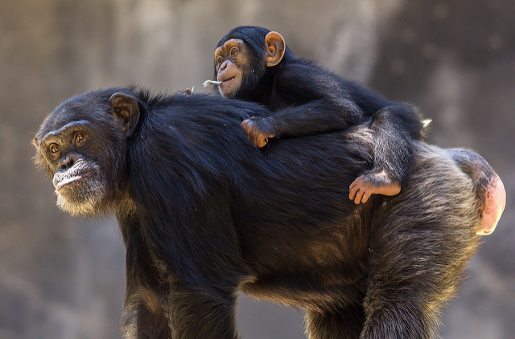
Features of Good Scientific Theories
Simplicity
Notes:
This slide discusses simplicity as a feature of a good scientific theory according to Thomas Kuhn, historian and philosopher of science. For instructors with limited time, it is suggested to focus the discussion on falsifiability.
Explanation: Simplicity, also known as parsimony/Ockham’s Razor, is the idea that when two ideas are equally good at explaining the data, chose the more simple of the two. Simplicity does not mean that you choose the most simple answer if the more complex one does a better job, just that simplicity of explanation should factor into our theoretical decisions.
Further Explanation: The picture here shows a chimpanzee. Chimpanzees are incredibly intelligent animals, capable of solving many different kinds of problems. However, when a chimpanzee solves a problem, do they have the same kind of mental representation that a human does or can the behavior be adequately explained by referring to non-mental processes (e.g., behaviorism/learning)? The more parsimonious explanation is the one that is the most simple: a non-mentalistic account of animal problem solving, one that doesn’t posit that chimpanzees (or other animals) have the same kind of inner-life and self-concept that we see in humans. This, of course, is an ongoing area of research as simple is only good when it represents the world accurately.
Note: The discussion about geocentric versus heliocentric is relevant here, too (see slide on accuracy). One of the reasons the geocentric was held for a while, even with some conflicting evidence is because (1) the evidence wasn’t sufficient yet and (2) circular orbits around the earth is a more simple model. In this case it was wrong, and ultimately abandoned.
Note: Parsimony is an element of scientific theories that is debated by scientists and philosophers. One of the reasons concerns ambiguity (how is “simple” defined independent of the theories it is trying to describe?). Another concerns the history of science: there are many instances of theories maintaining prominence because of parsimony, only to be rejected as an incomplete account. Simplicity is only beneficial when it is accurate.
Optional Activity: For Kuhn’s 5 features, an optional activity could include breaking students into groups to develop/search for specific examples of these features (historically or in recent research debates). Individual groups could each be given a different feature and asked to report back to the class with their examples. Examples could be used/elaborated/critiqued to illustrate these concepts.
Image: https://kids.nationalgeographic.com/animals/chimpanzee/#chimpanzee-with-baby.jpg

Slide 11
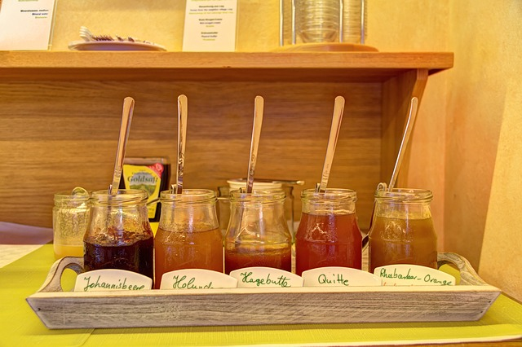
Features of Good Scientific Theories
Fruitfulness
Notes:
This slide discusses fruitfulness as a feature of a good scientific theory according to Thomas Kuhn, historian and philosopher of science. For instructors with limited time, it is suggested to focus the discussion on falsifiability.
Explanation: Fruitfulness is the idea that a good scientific theory will make specific predictions that can be tested. These tests can result in support for the theory or revision to the theory in its explanations of specific aspects of phenomena.
Fruitfulness is similar to scope in that it moves beyond currently available data; fruitfulness, however, is primarily concerned with moving beyond currently available data to produce specific, testable (falsifiable) predictions.
Further Explanation: For example: Although we intuitively believe that more choice is beneficial for happiness, there is some research suggesting that too much choice doesn’t increase happiness. Instead, it causes decision paralysis and reduces our well-being. This theory, known as the “paradox of choice” makes several predications about when choice is beneficial and when it is not. These are testable claims that contribute to the fruitfulness of the theory. For example, it predicts that we experience a certain amount of satisfaction after a choice between two options. However, when there are 30 options, we might objectively make a better choice (compared to the 2 option choice), but we will experience less subjective satisfaction (e.g., “out of 30 options, I should have found the perfect one!”).
One of the famous studies contributing to the paradox of choice is one in which consumers were exposed to a “taste” station for gourmet jams. The array had either 6 or 30 jams to taste. The results indicated that people were more likely to taste with 30 jams, but more likely to buy with 6 jams. The conclusion was that quantity of choice influences behavior.
Optional Activity: For Kuhn’s 5 features, an optional activity could include breaking students into groups to develop/search for specific examples of these features (historically or in recent research debates). Individual groups could each be given a different feature and asked to report back to the class with their examples. Examples could be used/elaborated/critiqued to illustrate these concepts.
Note: More on the paradox of choice, and some of the ongoing controversy with that theory, can be found in a summary here: https://www.pbs.org/newshour/economy/is-the-famous-paradox-of-choic

Slide 12
Features of Good Scientific Theories
Falsifiable
Explanation
THEORY PREDICTION
Notes:
This slide discusses falsifiability as a feature of a good scientific theory. Although falsifiability was not one of Kuhn’s key features, it is an essential aspect of science. Karl Popper is notable for this contribution to scientific thinking.
Explanation: Falsifiable means that something is able to be falsified; we are able to demonstrate it to be incorrect. Karl Popper popularized this idea as a key distinguisher between pseudoscience and real science. Pseudoscience, even when packaged nicely, couldn’t be demonstrated to be false. No matter what the outcome, the outcome could be explained in a way that was consistent with the pseudoscientific claim.
Note: The video linked in this slide (https://www.youtube.com/watch?v=wf-sGqBsWv4) is included in the “outside resources” section of the module. It is 2 minutes and discusses Popper’s views on falsification (searching for evidence that contradicts your beliefs/hypotheses). It applies his concept of falsification to Marxism. (Popper criticized Marxism and Freud’s psychoanalytic views quite a bit in his writing for the inability of these theories to be falsified.)
Further Explanation: In science, falsification refers to the ability for something to be demonstrated to be false. It also means that if we want to make a conclusion about something (e.g., the blue arrow/circle), we need to eliminate the other possible explanations (falsifying them). Popper’s idea was that if we eliminated all the things that weren’t true, we’d only be left with what is true. In psychology where there are multiple and interacting causes, when we can’t outright falsify something, we need to revise our theories to accommodate/explain the influence of it on the phenomenon at hand.
Discussion Topic: Why is falsification necessary in science? What’s wrong with searching for confirmatory evidence (what can result when we do this)?
Further Discussion Topic: Given the discussion on features of good scientific theories, especially this principle of falsification, why isn’t astrology, and the horoscopes produced by it, considered scientific?

Slide 13
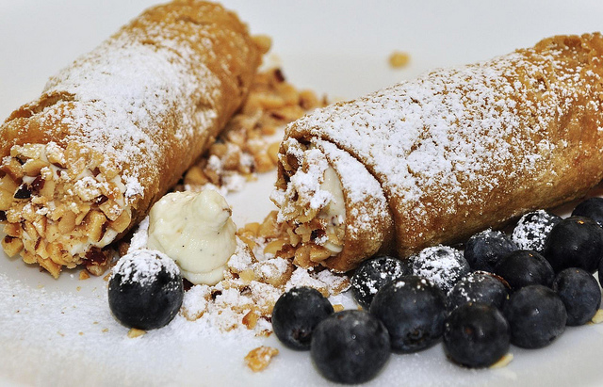
Which is falsifiable?
Classical music increases intelligence.
Eating before exams increases performance.
Cannolis are delicious.
The mind does not exist.
Notes:
Optional Activity: Ask students to discuss which of these statements are falsifiable, what kinds of evidence could be gathered to falsify it/how they could be modified to be made falsifiable. If time permits, ask them to develop a few hypotheses, phrased in a way in which they could be tested/falsified. Some are falsifiable, but would need to be made more specific in order to be tested.
Note: The fourth statement is included as a discussion starter. This is relevant to discussions about the limits of science. Science can offer physical evidence about the physical world. So can science provide answers about immaterial concepts (e.g., minds)? This is an ongoing debate. At minimum, it’s accurate to say that science cannot prove, nor can it disprove, the existence of any non-material thing. That doesn’t mean, however, that science can’t contribute meaningfully to the conversation. This conversation is most appropriate for upper-division students as it introduces a host of complicated ideas around consciousness, science, philosophy, and religion (among others).

Slide 14
Overview
Introduction
Scientific Reasoning and Theories
Interpreting Research (Correctly)
Trusting Science without Proof
Objectivity in Science
Conclusion
Notes:
The purpose of this slide is to provide an overview of the material that will be covered in the lecture.
Technical Note: These slides may contain simple click animation so that you can focus students’ attention on a particular question, a selection of text, or an image and not have them be distracted by reading ahead. You can either preview the sequence of animation by going through the slides in slideshow view, visiting the animations tab, or reviewing the slide notes. In the notes you will see a cue - (Click) – that corresponds to each animation.
You will also find hyperlinks to outside videos at various places in the slides. These hyperlinks are embedded in text and indicated by color and in the notes section.
Explanation: Now that we understand the elements of good scientific theories, features that also define qualities of good scientific thinking, let’s talk a bit about how to apply this kind of thinking to interpreting research results. Specifically, this discussion will focus on understanding falsification in the interpretation of scientific research.

Slide 15
Interpreting Research (Correctly)
Research Hypothesis:
Standing desks increase productivity
Standing Desks
(Experimental Group)
Typing Task (Measurement)
Random Assignment
Traditional, Seated Desks
(Control Group)
Notes:
This slide introduces a research hypothesis, test, and ways of interpreting it. Instructors can easily swap this example for an example in their own research or an example they will explore in a future lecture.
Discussion Topic: Consider this research hypothesis. One of the first things we need to do is develop an operational definition for “productivity”.
Question for students: Ask students different ways productivity might be operationalized. For example, does productivity mean that an individual types more words per minute? Takes less breaks? Processes more orders? Is more polite during phone conversations? Is more creative?
Let’s say that productivity is defined as “typing more words per minute.”
Question for students: How could this hypothesis be tested?
Explanation:
(Click): (Entire animation appears on click. Instructors may wish to stagger the animation to walk students through each step of this experimental process/design.)
This is one way to test the hypothesis that standing desks increase productivity, as measured by typing speed. Now comes the interesting part: what do we do with the results?
Note: Potential results and interpretations on next slide.

Slide 16
Do standing desks increase productivity?
3 Options:
Results Support Hypothesis
But what if….
Notes:
This slide discusses possible outcomes in the data and how we should/shouldn’t think about those outcomes.
Explanation:
(Click): The first option is that the typing speed is, on average, faster in the group at the standing desk compared to the group at the sitting desk.
Does this mean that the hypothesis has been proven? No! Why not? It turns out, there are a lot of questions we’d still need to ask.
(Click): Let’s pretend that these are our results. The blue dots represent people who type faster standing than sitting. These results would support our hypothesis because, on average, people are doing better standing than sitting.
This doesn’t prove that standing will lead to faster typing times because it’s a sample of the total population. What if there were something weird about that sample, or something weird about the groups? Or maybe the chair that the sitting group was using was just really uncomfortable. These questions, and others, beg the question about how well our sample distribution, the pattern of results we found, match the population distribution.
(Click): If you knew that this is what the population looked like, you might start to question the accuracy of the claim from the sample.
This is why it is so important for researchers to use samples that are representative of the population. Doing that will decrease the likelihood of a result like this: drawing a sample from the population that is somehow different from that population in meaningful ways.
So, in this circumstance, we can celebrate our findings as support of our hypothesis, but we still can’t talk about proof because of the probabilistic nature of how results/how the conclusion was reached.
Note: P-values and probabilities will be taken up again in the next section of this PowerPoint.

Slide 17

Do standing desks increase productivity?
3 Options:
Results Support Hypothesis
2. Results Contradict Hypothesis
Sitting > Standing
b. No difference between groups
Notes:
This slide discusses possible outcomes in the data and how we should/shouldn’t think about those outcomes.
Explanation: (Each option on click.)
(Click): A second option is that the hypothesis was not supported. There are two possibilities for this.
(Click): We could find that the group of participants who were seated typed, on average, faster than the group of individuals who were standing.
(Click): Alternatively, we could find that neither group performed faster than the other. In this circumstance the hypothesis wasn’t supported because standing didn’t increase typing speed, but we don’t see a decline in performance, relative to the seated group.
In the same way that finding evidence for our hypothesis doesn’t prove that the hypothesis is true, finding evidence against our hypothesis doesn’t prove that our hypothesis is false. The same questions we asked after the supportive evidence would be asked in this circumstance. These questions would also include questions about the theory: when there is a strong theoretical reason to suspect a hypothesis, we are more likely to question results that are inconsistent with that theory. In science this involves more research and data. With sufficient data that is inconsistent with a theory, the theory may eventually be rejected or amended. One study, however, is not enough to throw a theory out (given the possibilities presented by the probability inherent in scientific, inductive reasoning.)

Slide 18
Overview
Introduction
Scientific Reasoning and Theories
Interpreting Research (Correctly)
Trusting Science without Proof
Objectivity in Science
Conclusion
Notes:
The purpose of this slide is to provide an overview of the material that will be covered in the lecture.
Technical Note: These slides may contain simple click animation so that you can focus students’ attention on a particular question, a selection of text, or an image and not have them be distracted by reading ahead. You can either preview the sequence of animation by going through the slides in slideshow view, visiting the animations tab, or reviewing the slide notes. In the notes you will see a cue - (Click) – that corresponds to each animation.
You will also find hyperlinks to outside videos at various places in the slides. These hyperlinks are embedded in text and indicated by color and in the notes section.
Explanation: So, the major take home of that example is that if we get evidence that supports or refutes our hypothesis, we can’t say that we’ve proven a hypothesis true or false. That begs the question: so why should we ever trust scientific claims if nothing is proven?

Slide 19

What has science proven?
Notes:
Optional Activity: Have a group discussion about things they have heard have been “proven by science” or break students into small group and have them search the internet for “things science has proven”.
In this activity, one of the key things you will want to do is note the sources of these claims. Part of why “proof” is so common in our thinking about science is because most of us get our science from popular reports of science. This is great, but it also means that there will be some shortcuts. (And, in the same way that not all research is created equal, not all science journalists equally engage with the complexities and nuances of scientific research.)
The goal of this activity is not to create skepticism toward science, but to set the stage for the content to come, which focuses on why science is trustworthy, even in the absence of “proof” (as understood with deductive reasoning).

Slide 20
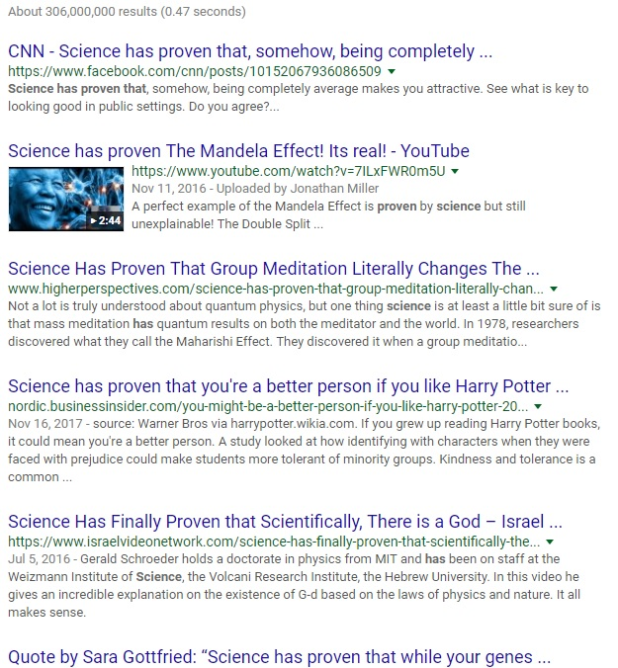
Trusting Science without Proof
Why do you think media reports of science talk about “proof”?
Notes:
This slide discusses why it might be surprising to come to the conclusion that science doesn’t prove things. This slide also sets the discussion to follow that even without proof, science is trustworthy.
Discussion Topic: Why do you think media reports of science talk about proof? Consider the purpose of media/reporting versus the purpose of scientific reports.
Explanation: Oftentimes, media reports of science will describe scientific evidence as proof of some phenomenon or another. Now that you know that this kind of proof isn’t consistent with the probability of the scientific method, that there is always the possibility of error (when the evidence is or is not consistent with your hypothesis!), does this mean that we should treat scientific research and conclusions as no different than our own inductive reasoning, based on anecdote and personal beliefs? No! To understand why not, let’s look at a practice in psychology: null-hypothesis significance testing.
Slide image of a screenshot I took of a google search for the terms “science has proven that” on 11/30/17

Slide 21
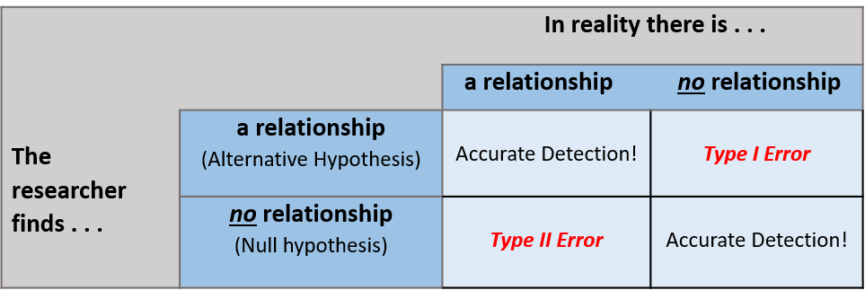
Null-Hypothesis Significance Testing
H₀=No relationship vs. H_{A}=There is a relationship
Notes:
This slide discusses null-hypothesis significance testing.
Explanation: In NHST, a researcher is testing the alternative hypothesis, their hypothesis, against a null hypothesis, a hypothesis of no relationship. The default assumption of NHST is that there is NOT a relationship between variables. This default stance—one of skepticism—is a the core of thinking scientifically (e.g., falsifiability looks for evidence that contradicts, rather than confirms, beliefs).
NHST assesses the probability that the collected data (the observations) would be the same if there were no relationship between the variables of the study. So, IS there a relationship between the use of standing desks and typing speed? The null hypothesis would say “no relationship”, the alternative hypothesis, the one the researchers are testing, would say, “yes, typing speed is different if you sit versus if you stand.”
These hypotheses are examined by comparing distributions of the data we collected to distributions of what the data would look like if there was not a relationship. When these distributions are sufficiently different, we reject the null hypothesis in favor of the alternative. In other words, we have support for the alternative in that context. (We haven’t “proven” or “accepted” the alternative, just provided evidence in favor of.)
(Table on Click): In NHST we have to account for two things: what our data show and what is actually out there. We hope that our data match reality, but because we haven’t measured every single instance and there is always the possibility of things like measurement error, we can’t measure reality directly. We infer if based on our data.
So, there are a couple of possible outcomes, then.
(Circle on click): First, we can have data that cause us to reject the null hypothesis in favor of the alternative, and this could accurately represent reality. In this circumstance, we have accurately detected the relationship between variables that is out there.
(Circle on click): Alternatively, our data could cause us to fail to reject the null hypothesis. Our data suggest that there is no relationship between the variables. When this is true in the world, we have also accurately detected a non-relationship between variables.
(Circle on click): Another possibility is that we find a relationship in our data when none actually exists. We call this a Type I error. A Type I error is established by the probability-value or threshold that a researcher establishes in their data analyses. So, they might set a p-value of .05. If they reject the null hypothesis with a p<.05 statement, they are essentially saying that if this study were repeated 100 times, results this extreme would happen by chance alone less than 5 of the 100 times.
This gives us a metric of how confident we should feel when we reject the null hypothesis. When a researcher claims that daily exercise increases happiness, p<.05, you have a sense of the likelihood that this finding is the result of one of some kind of error in the data. (Less than 5 out of 100.)
(Circle on click): A final possibility is that your data show no relationship and you are unable to reject or falsify the null hypothesis. When there actually is a relationship between variables but your data don’t show this, that’s called a Type II error.
One reaction to learning about p-values and Type I errors is to say that we want the risk of a Type I error to be low, so let’s set the p-value at .00001. That’s fine, but it increases the likelihood that you’ll miss a real relationship in your data. When you lower the p-value to decrease a Type I error, you increase the chances of a Type II error.
Further Explanation: In a clinical trial of an over-the-counter medicine, Zicam, evidence indicated that the use of the medication sometimes caused a loss of smell. The company, however, did not report this because their data was not statistically significant. That is, their data indicated no relationship between the use of the medication and loss of smell. The US Supreme Court, however, deemed that failure to reject the null hypothesis could have been a Type II error.
Similar results have occurred in other research (e.g., medical research on asprin) where an effect might not reach the thresholds required to reject the null hypothesis, but that doesn’t mean the result is unimportant.
Note: More on Zicam, significance, and importance: http://asq.org/quality-progress/2011/08/statistics-roundtable/not-significant-but-important.html
Note: More advanced classes might benefit from a discussion of the limits and criticisms of this method, and a discussion of alternative ways of approaching data.

Slide 22
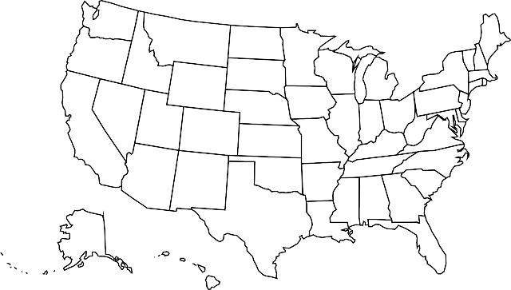
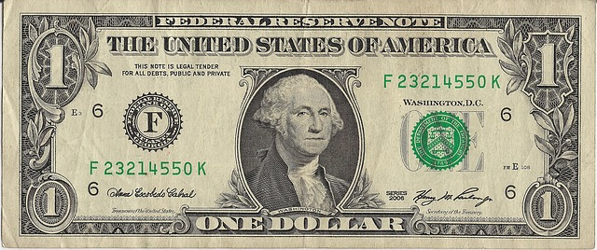
Trusting Science without Proof
Notes:
This slide provides a conclusion statement to the previous discussion about NHST.
Explanation: It’s because of the methodology of science, including tests like NHST which provide a standard of comparison and a specific language to gauge the confidence in a statement (p of .05 or .10?).
Although science cannot prove its statements, it has methods built in to allow for the assessment of the likelihood of the outcomes. Pair this with the methods of science (large, representative samples, quality measurements, etc.), and we have a trustworthy, even if unproven, claim.
Further Explanation: Sometimes individuals respond to the lack of proof in science with a kind of exasperation like, “if science can’t prove then it’s no different than my beliefs. All opinions, including scientific ones, must be equal.” The point of this discussion is that this is an incorrect statement. Some beliefs are better beliefs, having more evidence in support of them.
Imagine that you had $2 to play the lottery. In the US, one of the kinds of lotteries you can play is the “Powerball.” In a recent analysis of Powerball winning odds, players had a 1 in 175 million chance. This is such a small chance it’s hard for us to grasp just how small it is. Despite the incredible low odds, millions of people still buy tickets assuring themselves that “this is a good bet.” Let’s assess if the bet is actually a good bet. If the chances are 1 in 175 million, let’s get 175 million $1 bills. Turns out, this is enough bills to circle the entire United States: TWICE. So, your odds of winning the lottery would be the same as you picking the magic $1 bill on the correct loop of this very lengthy journey.
This is not to say that playing the lottery is wrong, just that the assumption that it’s a good use of $2 (e.g., a likely bet) is wrong. Some bets are better bets. Probability is the metric of this difference and science has this built in.
Note: Chances of winning the powerball: https://www.huffingtonpost.com/ronald-l-wasserstein/chances-of-winning-powerball-lottery_b_3288129.html

Slide 23
Overview
Introduction
Scientific Reasoning and Theories
Interpreting Research (Correctly)
Trusting Science without Proof
Objectivity in Science
Conclusion
Notes:
The purpose of this slide is to provide an overview of the material that will be covered in the lecture.
Technical Note: These slides may contain simple click animation so that you can focus students’ attention on a particular question, a selection of text, or an image and not have them be distracted by reading ahead. You can either preview the sequence of animation by going through the slides in slideshow view, visiting the animations tab, or reviewing the slide notes. In the notes you will see a cue - (Click) – that corresponds to each animation.
You will also find hyperlinks to outside videos at various places in the slides. These hyperlinks are embedded in text and indicated by color and in the notes section.
Explanation: So, the conclusion so far is that (1) science cannot prove its findings but (2) it is trustworthy because of how it makes its claims. This trust in science is strengthened when we think about the qualities of good scientific theories and thinking.
What a scientific theory does, a theory that is accurate, consistent, sufficient in scope and simplicity, is fruitful and able to be falsified, this theory provides a trustworthy framework for thinking about particular phenomena. Of course, theories can (and are) changed with evidence, but that is part of their strength. Individual studies don’t dictate the theory, but theories move in response to extensive bodies of research. So, individual studies take probability into account and theories look across many, many studies.
Note: The TED talk by Naomi Oreskes, a historian of science, available in the “outside resources” section of the module deals with this issue. Science is a form of authority (e.g., individual scientists have a limited scope of scientific expertise), but that it is different from traditional methods of authority in that is a collective, democratic authority based on evidence and increasing alignment with reality. In many ways, her talk demonstrates the idea in the paragraph above.

Slide 24
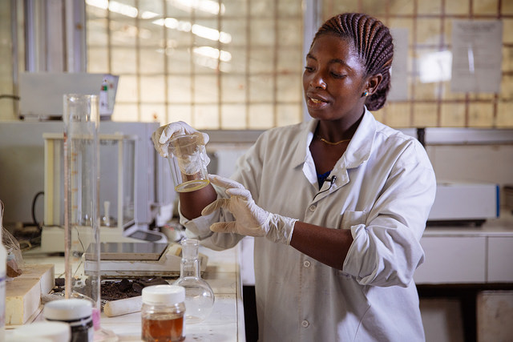
Objectivity in Science
Notes:
This slide discusses the issue of objectivity in science.
Explanation: If we follow the implications of this discussion a bit further, we will see that the image of a scientist as an objective, unbiased observer to the natural world is not accurate. There are too many choices made by the scientist themselves throughout the scientific process that will impact research results.
Discussion: What are some of the decisions that a scientist makes? Think about this in the context of psychology.
Example responses: what questions to study, how to measure the variables, who to recruit in a sample, time/frequency/duration of testing, p-value level, etc.
Further explanation: It’s okay that scientists aren’t completely objective in their work, but it is important to understand this, especially as we think about the value of one study compared to the value of a program of research and the scientific theory that pulls that research together.
That scientists are not objective has been referred to as the “fact-value distinction.” Facts are statements about the world and values are our beliefs about the way the world ought to be. Our values will inform the kinds of questions that we ask and how we ask them, which will in turn influence our results for any single study. The take home point? Rather than being cold and dispassionate observers, scientists are active in the process of gathering information about the world and interpreting that information to make sense of it (especially in the social sciences).
As a result, science works best when people with diverse values and backgrounds work collectively to understand complex natural phenomena.

Slide 25
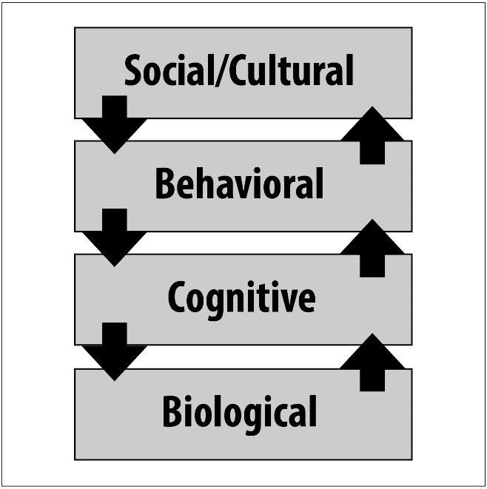
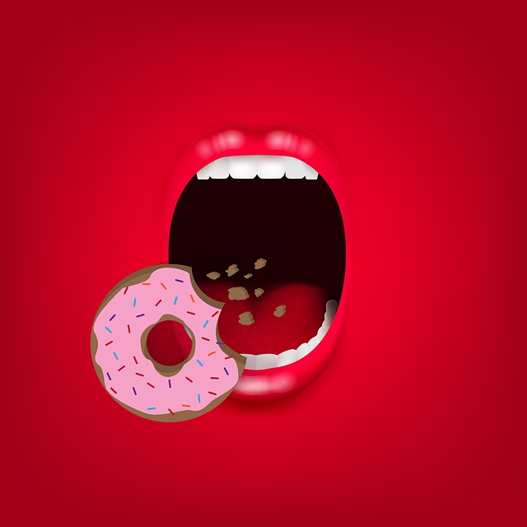
Diverse Perspectives in Science
Levels of Analysis
Notes:
This slide discusses the concept of levels of analysis.
Explanation: One of the ways that diversity improves the scientific process is by thinking about levels of analysis. Levels of analysis is the idea that the same phenomenon can be explained in multiple ways. For example, consider hunger. What causes hunger? There are multiple ways to answer this question, and a full understanding of hunger will involve thinking about all of these explanations.
Further Explanation: For example, biological explanations for hunger might focus on the different roles of leptin (a hormone that is associated with hunger) and ghrelin (a hormone associated with satiety). A cognitive explanation might focus on thought processes (e.g., the role of stress in hunger/eating or food preferences). Behavioral explanations might focus on conditioning (e.g., the clock hitting noon as a signal for lunch) or associations learned in advertising or one’s socialization history. Social/cultural explanations might focus on the role of societal expectations/body image (e.g., hunger suppression in cultures with a thin ideal) or cultural expectations for celebrations.
Levels of analysis suggests that one of these answers is not more correct but that all are important in a complete understanding of the experience of hunger.
Further Discussion: Some scientists endorse reductionist explanations for phenomena (e.g., hunger is purely biological; all of the higher level experiences are ultimately fully understood by breaking them down to their biological parts). This is an ongoing debate; advanced classes may enjoy engaging in this discussion. The short article by M. Gazzaniga in the outside resources section of the module or this article by D. Amodio (2010) on how neuroscience and social psychology can together contribute to a better understanding of complex phenomena may be useful to think about the independent, but complimentary role of different levels (and ways) of explaining. Amodio article: http://www.psych.nyu.edu/amodiolab/Publications_files/Amodio_2010_SocialCognition.pdf
This can also be used to structure a discussion about the domain of science (what it can say and what it can’t), as related to the fact-value distinction.
Some interesting points for discussion: Science measures physical things, but does it tell us if that is all there is? (See “mind” question in slide 13.) Science can measure what people think is moral behavior, but can it tell us what is moral? Scientists actively argue about these questions, making them ongoing questions/dialogue.

Slide 26
Overview
Introduction
Scientific Reasoning and Theories
Interpreting Research (Correctly)
Trusting Science without Proof
Objectivity in Science
Conclusion
Notes:
The purpose of this slide is to provide an overview of the material that will be covered in the lecture.
Technical Note: These slides may contain simple click animation so that you can focus students’ attention on a particular question, a selection of text, or an image and not have them be distracted by reading ahead. You can either preview the sequence of animation by going through the slides in slideshow view, visiting the animations tab, or reviewing the slide notes. In the notes you will see a cue - (Click) – that corresponds to each animation.
You will also find hyperlinks to outside videos at various places in the slides. These hyperlinks are embedded in text and indicated by color and in the notes section.

Slide 27





Conclusion
Notes:
Explanation: What can we conclude then? There are many ways of knowing. We can rely on common sense, personal experience, faith, and/or science. (Probably some combination of all of these!) In their own ways, each is important, but they are not necessarily equal; this is the primary conclusion of this module: even though beliefs from different sources might all be “unproven” this doesn’t make them equal. Learning to differentiate the trustworthiness of different claims, including scientific claims, is key in our process of becoming competent and contributing members of societies. (Note even in that, a value statement, that truth matters. See the TED talk by Michael Patrick Lynch in the Outside Resources for more on that.)
Optional Activity: Divide the students into groups and have them read a research study. Ask them to comment on the various elements of the article, as discussed in this module:
What is the theory/hypothesis being tested?
How are they testing it? (Can the measurement be trusted? Who is the sample?)
If possible, ask them to identify a p-value statement and describe what it means. Given that the module is conceptual, they may not have the skills to do this (which requires reading and understanding a results section).
What conclusions are offered by the researchers, based on this research?
Identify the potential influence of researcher values in the article.
How could this research benefit from data collected at a different level of analysis?
Note: Some potential articles for this activity can be found on the Div 2 Website, resource tab here: http://teachpsych.org/resources/Documents/otrp/resources/ciarocco10.pdf
Image: http://www.basicknowledge101.com/subjects/knowledgemanagement.html

Slide 28

CAT: One-Minute Paper
What was the most important thing you learned during this class?
What important question remains unanswered?
Notes:
Classroom Assessment Technique (CAT): One-Minute Paper
If you are presenting the information on one class day, you might end the material about here. End your class time with a one-minute paper.
The Minute Paper tests how students are gaining knowledge, or not. The instructor ends class by asking students to write a brief response to the following questions: “What was the most important thing you learned during this class?” and “What important question remains unanswered?”
Discussion/Conclusion Questions::
Go back to the activity from the beginning of class. As you think about why you believe what you do about health, what other things should you consider? (e.g., where did the information come from? Does it account for multiple levels? What’s the role of fact/value? What are the relevant theories about health/which are trustworthy statements about health?)
Have students briefly answer these questions in writing and turn them in. After class, assess students’ responses. At the beginning of the next class, go over any misunderstandings or relevant questions.
If you do not conclude with this Classroom Assessment Technique (CAT), it would helpful to use another CAT. It could be in the form of a:
Muddy point
One-minute paper
Background knowledge
What’s the Principle?
Defining features Matrix:
For more information on CATs click here: http://cft.vanderbilt.edu/guides-sub-pages/cats/

Slide 29
Photo Attribution
Slide 1 | Photo Credit: Scientific Methods Zappys Technology Solutions https://www.flickr.com/photos/102642344@N02/9998429226 https://creativecommons.org/licenses/by/2.0/
Slide 3 | Photo Credit: Meditation Sri Lanka Amila Tennakoon https://commons.wikimedia.org/wiki/File:Meditation_in_a_yoga_asana.jpg#/media/File:Meditation_in_a_yoga_asana.jpg https://creativecommons.org/licenses/by/2.0/
Slide 5 | Photo Credit: Information KatarzynaTyl https://pixabay.com/en/information-hotel-internet-network-1931373/ https://creativecommons.org/publicdomain/zero/1.0/deed.en
Slide 7 | Photo Credit: Differential Calculus geralt https://pixabay.com/en/differential-calculus-board-school-2820657/ https://creativecommons.org/publicdomain/zero/1.0/deed.en Photo Credit: Earth Comfreak https://pixabay.com/en/earth-moon-ache-sunrise-space-all-1388003/ https://creativecommons.org/publicdomain/zero/1.0/deed.en
Slide 8 | Photo Credit: Several cultivars of apples purchased in Pittsburgh, PA. From left to right: Golden Delicious, SweeTango, Granny Smith, and Gala. Dllu. https://commons.wikimedia.org/wiki/File:Golden_Delicious,_SweeTango,_Granny_Smith,_and_Gala_apples_3.JPG#/media/File:Golden_Delicious,_SweeTango,_Granny_Smith,_and_Gala_apples_3.JPG https://creativecommons.org/licenses/by-sa/4.0/
Slide 9 | Photo Credit: Neurons geralt https://pixabay.com/en/neurons-brain-cells-brain-structure-1739997/ https://creativecommons.org/publicdomain/zero/1.0/deed.en
Slide 10 | Photo Credit: Chimpanzee Mom and Baby Robert Moran https://www.flickr.com/photos/7654576@N02/14653025323 https://creativecommons.org/licenses/by/2.0/
Notes:
Photo Attribution Slide

Slide 30
Photo Attribution
Slide 11 | Photo Credit: Jam Unknown Author https://pixabay.com/en/jam-apricots-apricot-cook-2444939/ https://creativecommons.org/publicdomain/zero/1.0/deed.en
Slide 13 | Photo Credit: Mmm... Cannolis jeffreyw https://www.flickr.com/photos/jeffreyww/5903012696 https://creativecommons.org/licenses/by/2.0/
Slide 17 | Photo Credit: Question mark made of puzzle pieces Horia Varlan https://www.flickr.com/photos/horiavarlan/4273168957 https://creativecommons.org/licenses/by/2.0/
Slide 19 | Photo Credit: Man geralt https://pixabay.com/en/man-woman-question-mark-problems-2814937/ https://creativecommons.org/publicdomain/zero/1.0/deed.en
Slide 22 | Photo Credit: USAClker-Free-Vector-Images https://pixabay.com/en/usa-map-united-states-of-america-35713/ https://creativecommons.org/publicdomain/zero/1.0/deed.en Photo Credit: Dollar HealthWyze https://pixabay.com/en/dollar-money-bill-legal-tender-926397/ https://creativecommons.org/publicdomain/zero/1.0/deed.en
Slide 24 | Photo Credit: Chemist in a Lab IFPRI –IMAGES https://www.flickr.com/photos/49258007@N03/27835121703/ https://creativecommons.org/licenses/by-nc-nd/2.0/
Slide 25 | Photo Credit: Frame apisutme012 https://pixabay.com/en/frame-eat-snacks-mouth-1991993/ https://creativecommons.org/publicdomain/zero/1.0/deed.en
Slide 28 | Photo Credit: Illustrated silhouette of a black cat nehtaeh79 http://www.freestockphotos.biz/stockphoto/16624 http://creativecommons.org/publicdomain/zero/1.0/
Notes:
Photo Attribution Slide

